Slide 1
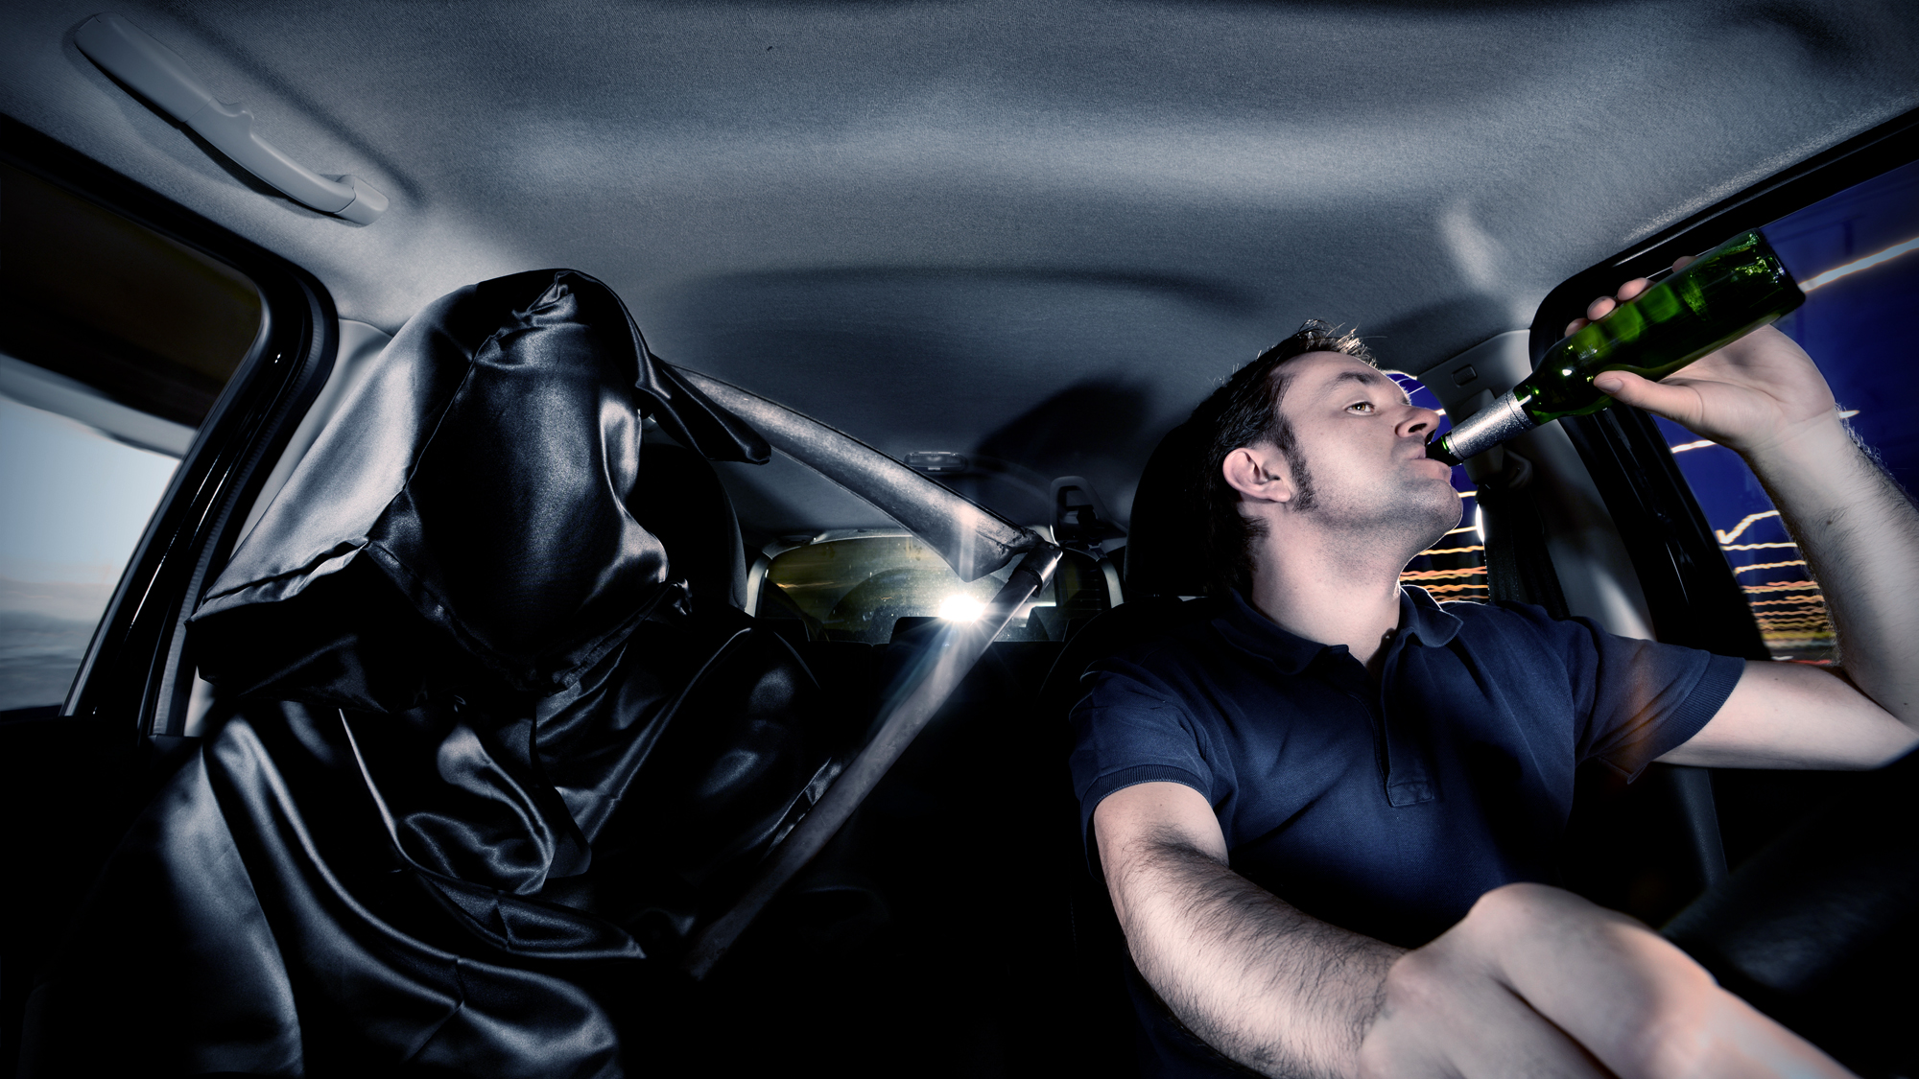
Road Buzzed
Another Look at Impaired Driving

Slide 2
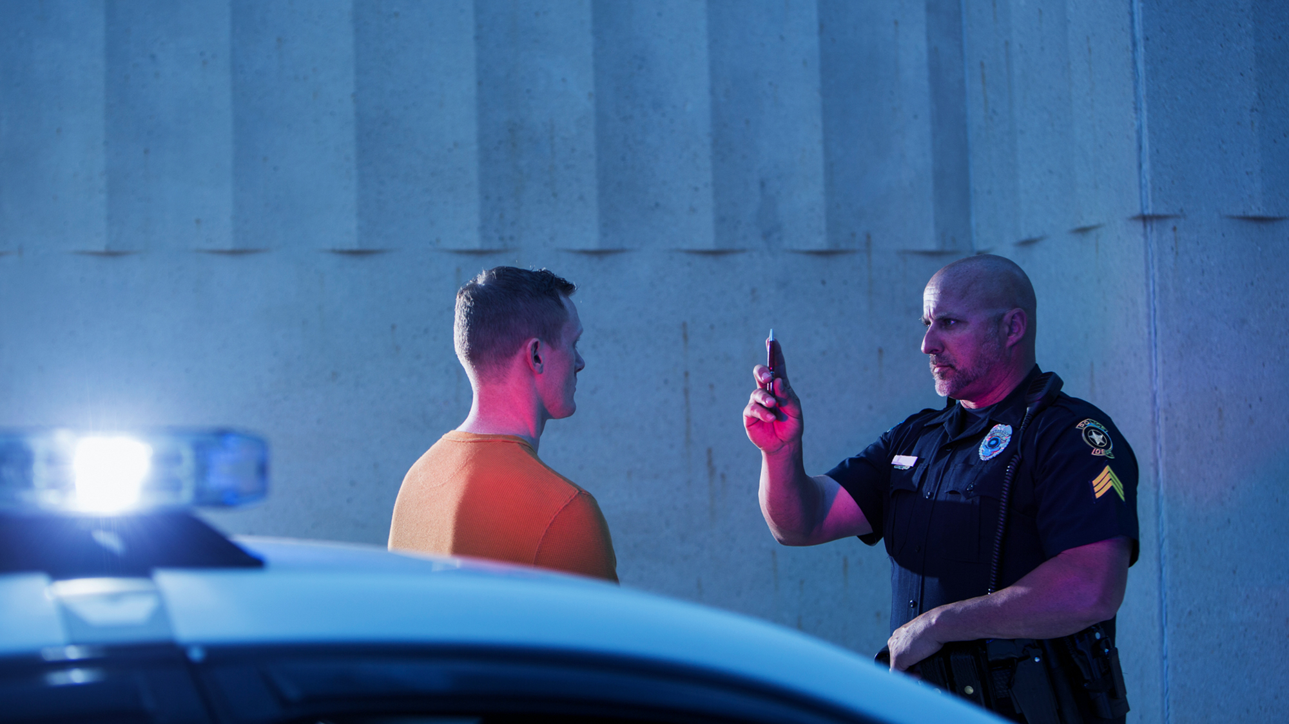
What Is Impairment?
Altered ability to function and make safe judgments.
Notes:
Discuss with your audience what impairment is and what can cause impairment.
Develop and practice strategies to prevent, avoid, or get out of dangerous impaired-driving situations.
Participate in collaborative discussions in small and large groups about impaired driving.
Slurred speech
Shaking
Stumbling or tripping
Glossy or drooping eyes
Frequent yawning
Changing lanes frequently or passing other vehicles improperly
Overshooting or ignoring traffic signs and signals
Hugging or driving on the shoulder of the road
Straddling the center line
Tailgating
Turning widely at intersections
Failing to dim high beams to oncoming traffic

Slide 3
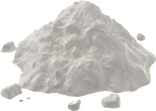
What can cause impairment of a person’s ability to drive safely?
Alcohol
Prescription Drugs
Over
the Counter Drugs
Illegal Drugs
Tiredness
3
Notes:
Discuss the different types of impairment seen here and ask your audience if they can come up with others and the effect each of the above can have.

Slide 4
Impaired Driving
Causes a Death every
50
minutes
4
Notes:
Make this fact real to your audience by doing a comparison. (one person in this room could die before this session is over)
Source: CDC

Slide 5
Think before taking the passenger seat
It’s not always easy to speak up to your friends, but practicing how to handle a situation before it happens can help prepare you.
Notes:
Ask your audience to share any experiences that they may have encountered or heard about concerning an impaired driver. Offer different scenarios and ask what they did or how they would handle it.
KEEP THESE TWO QUESTIONS IN MIND
1. What might prevent a passenger from saying something to a friend who is an impaired driver?
2. What are the potential consequences if the passenger does not speak up?
Passengers don't always recognize the warning signs, or don’t realize their friends are impaired.
Their friends tell them that they're okay to drive.
They trust that their friends won't hurt them.
They may be afraid to be judged or not be accepted by their peers.
The passenger doesn't have a license and doesn't feel like he or she has an option.

Slide 6
Road Buzz - Impaired Driving
6
Notes:
Running Time: 2:58

Slide 7
Identify ways to
Get Out, Avoid, or Prevent
a dangerous situation if someone seems impaired while driving or is about to take the wheel.
7
Notes:
Encourage your audience to speak up for passenger safety. Here are some suggestions:
Don’t get in the car if someone seems impaired
Speak up! Tell him/her not to drive
Tell them you don't feel comfortable
Tell them you care about them and it’s too risky
Remind them about the law/facts
Offer an alternative

Slide 8
Myths & Facts
Beer
12 oz.
Wine
5 oz.
Liquor
1.5 oz.
8
Notes:
Inform your group that taking a cold shower or drinking coffee will NOT sober you up. The only way to ensure that your driving is not impaired is to be sober. Even though beer may not have a high alcohol content, often a person consumes more and it becomes equivalent to a shot or more liquor.

Slide 9
Ashley’s Story
Road Buzz - Myths & Facts
9
Notes:
Running Time: 1:23

Slide 10
Alcohol Poisoning
Drinking quickly in a short period of time
Confusion
Hypothermia (the person's body temperature drops)
Pale skin, or a bluish tint
Unresponsive but conscious
Passing out
Unusual breathing rhythm
Vomiting
10
Notes:
Discuss the signs of alcohol poisoning and what you should look out for.
CRITICAL SIGNS & SYMPTOMS OF ALCOHOL POISONING
Mental confusion, Stupor
Coma, or person cannot be awakened
Vomiting
Seizures
Slow or irregular breathing
Hypothermia (low body temperature), bluish skin color, paleness.

Slide 11
Road Buzz - Alcohol Poisoning
11
Notes:
Running Time: 1:28

Slide 12
What do you do?
Call 911
Don’t Let Them Lie Down, Keep Them Sitting Up
If Not Conscious, Lie On Side
Check for Breathing
12
Notes:
Recap.
Here are some steps:
Above all, CALL 911. Don’t wait.
If the person is awake, don’t let them lie down. Try to keep them sitting.
If the person appears to not be conscious, check their breathing.
Lay the person on their side so he/she doesn’t choke on their own vomit.
Check their skin color and body temperature.
Don’t wait for ALL symptoms to show before helping.

Slide 13
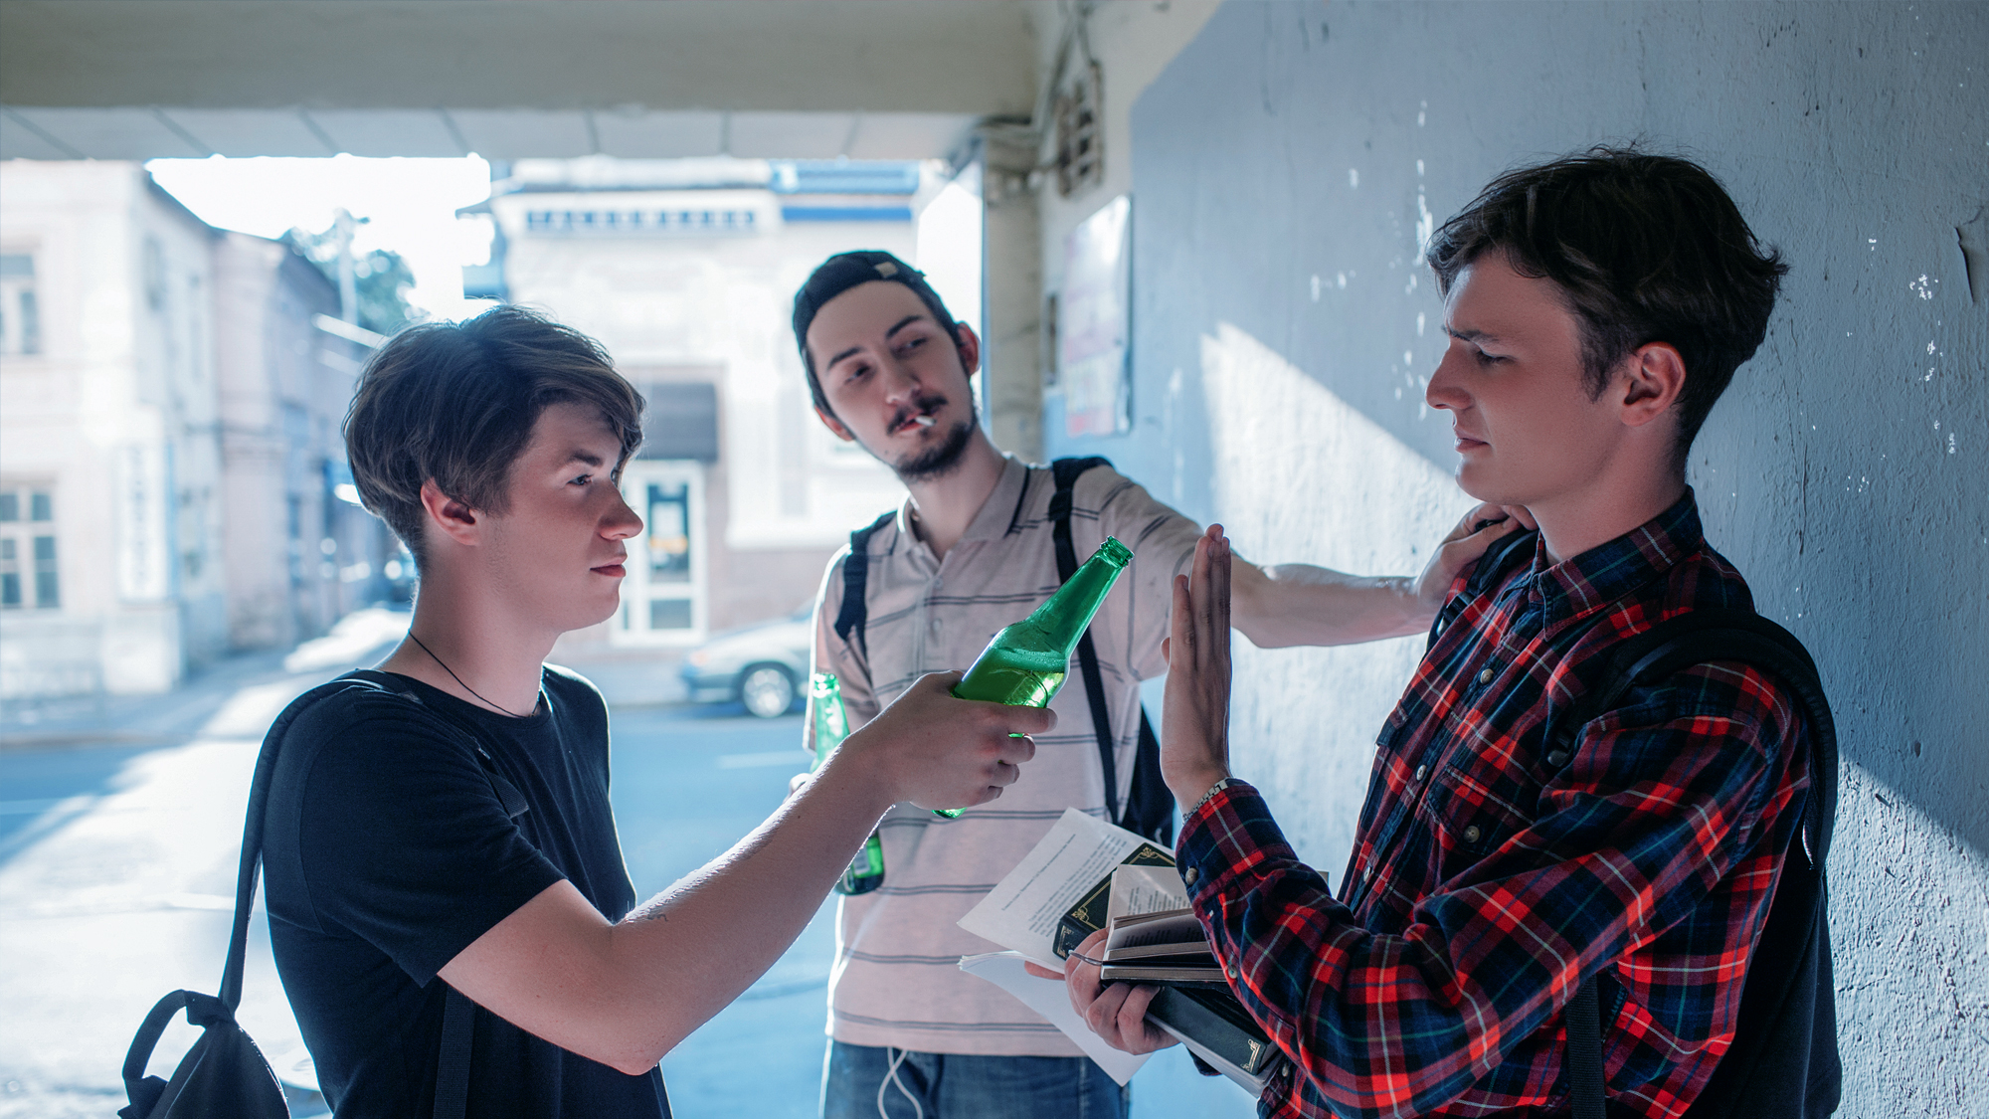
Peer Pressure
13
Notes:
Discuss the meaning of peer pressure. Ask your audience if they’ve ever experienced pressure from their friends and how did they handle it. Present scenarios to them and ask what would they do in each scenario.

Slide 14
I don’t want to look like a wimp!
No one ever listens to me anyway…
I’m too shy to talk up…
No one else is saying anything…
I just want to fit in…
Notes:
Have students discuss the different ways they might give in to peer pressure and then ask what they might do to overcome that peer pressure so the can speak up.

Slide 15
Road Buzz - Peer Pressure
15
Notes:
Running Time: 2:09

Slide 16
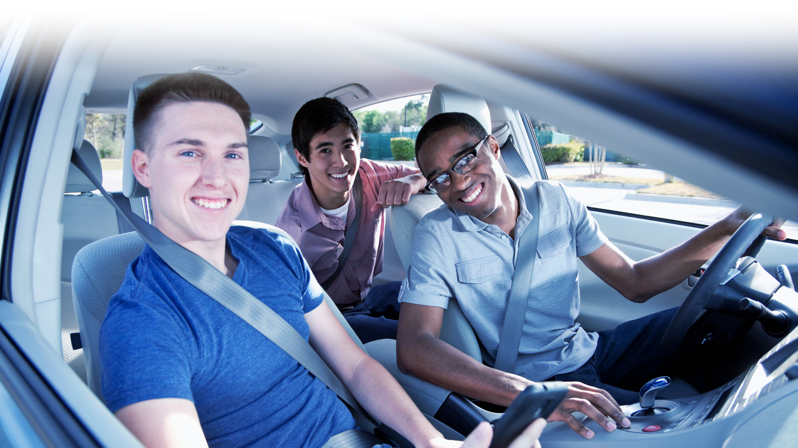
Buddy System
16
Notes:
Discuss having a “buddy system.”
Plan ahead.
Travel with a group of friends that share your same concerns on being safe.
Watch each other’s back.
Discuss the idea of a code word or phrase you can use with parents and friends.

Slide 17
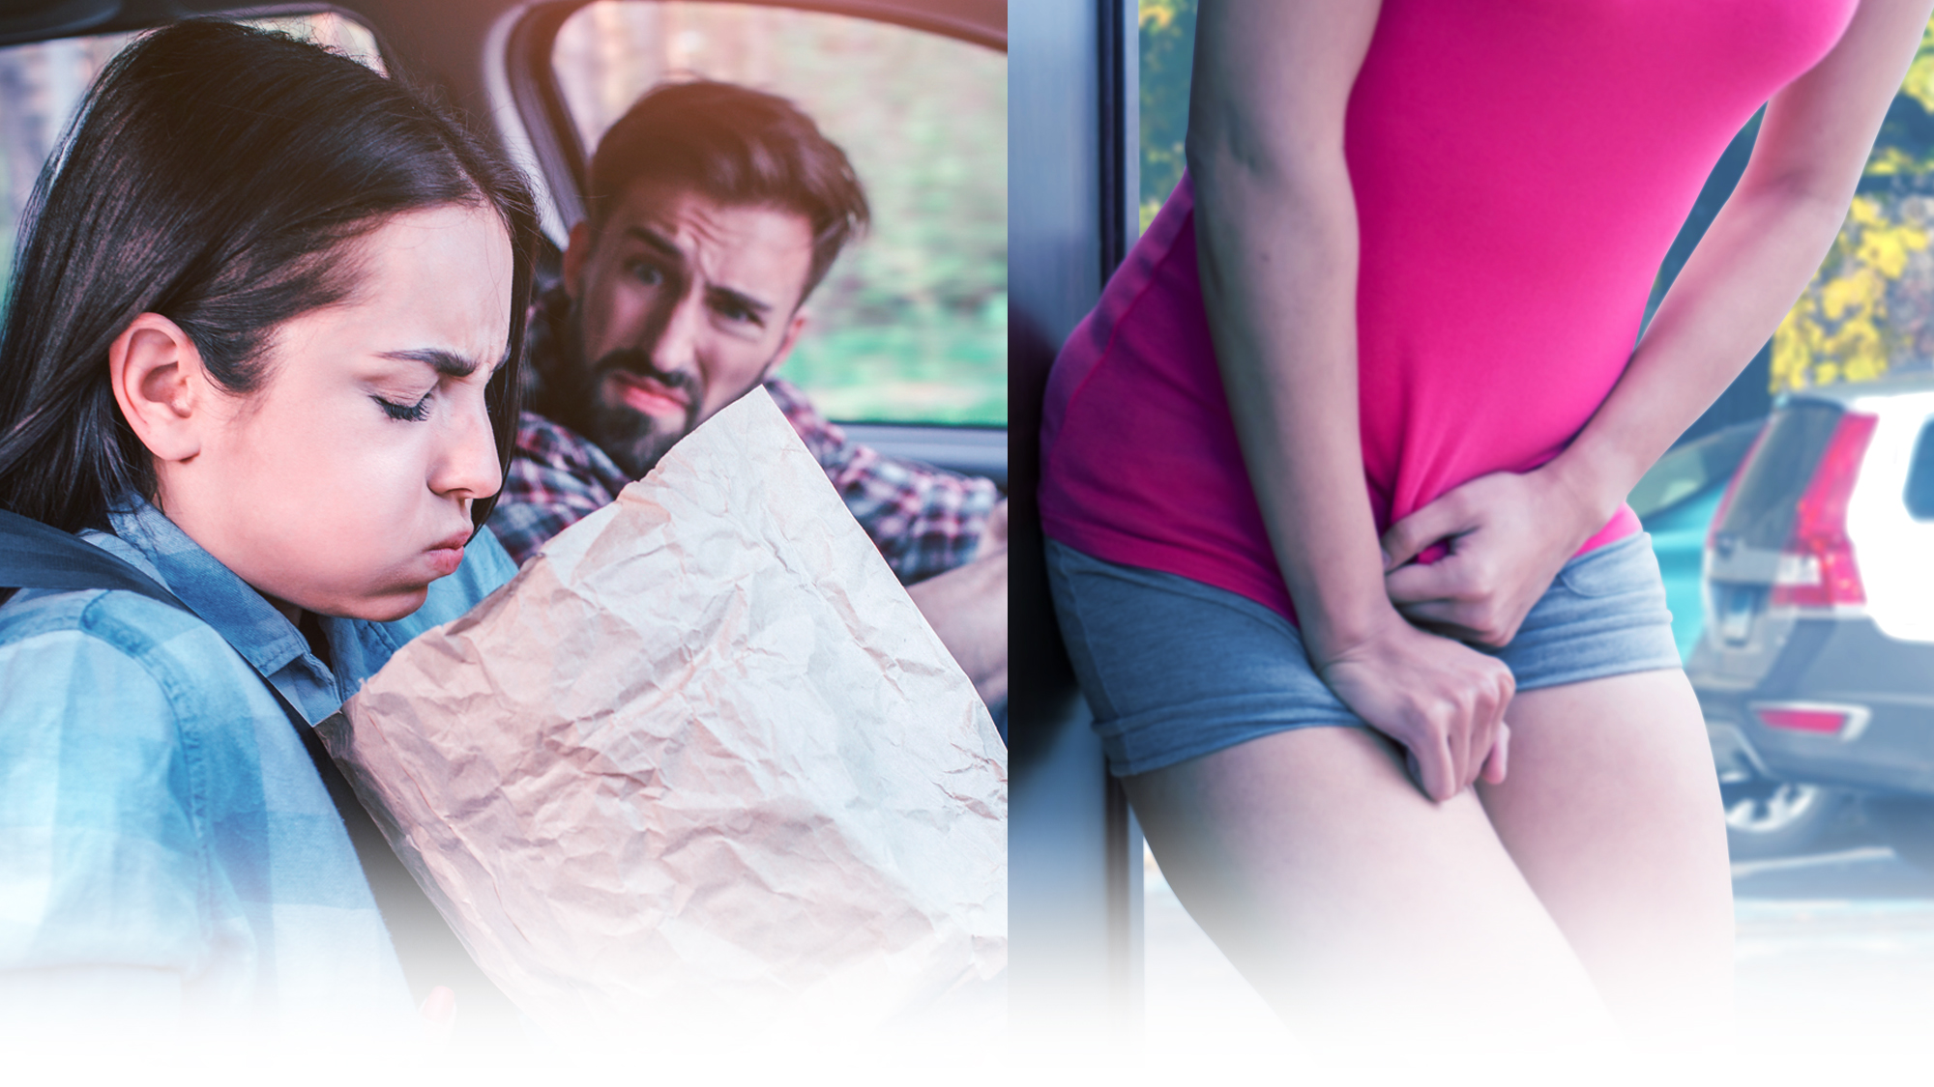
2 P’s
17
Notes:
Ask the driver to safely pull over. If the driver refuses, hold your stomach and tell the driver you think you're going to puke. Another method is to frantically squirm in your seat and tell the driver you have to pee. No one wants puke or pee on their car seats!

Slide 18
Have Alternatives
18
Notes:
Discuss other options.
Have taxi numbers available
Ask your sibling or parent to be on stand by
Discreetly hide the driver’s key
Stay at a friends home with parent approval

Slide 19
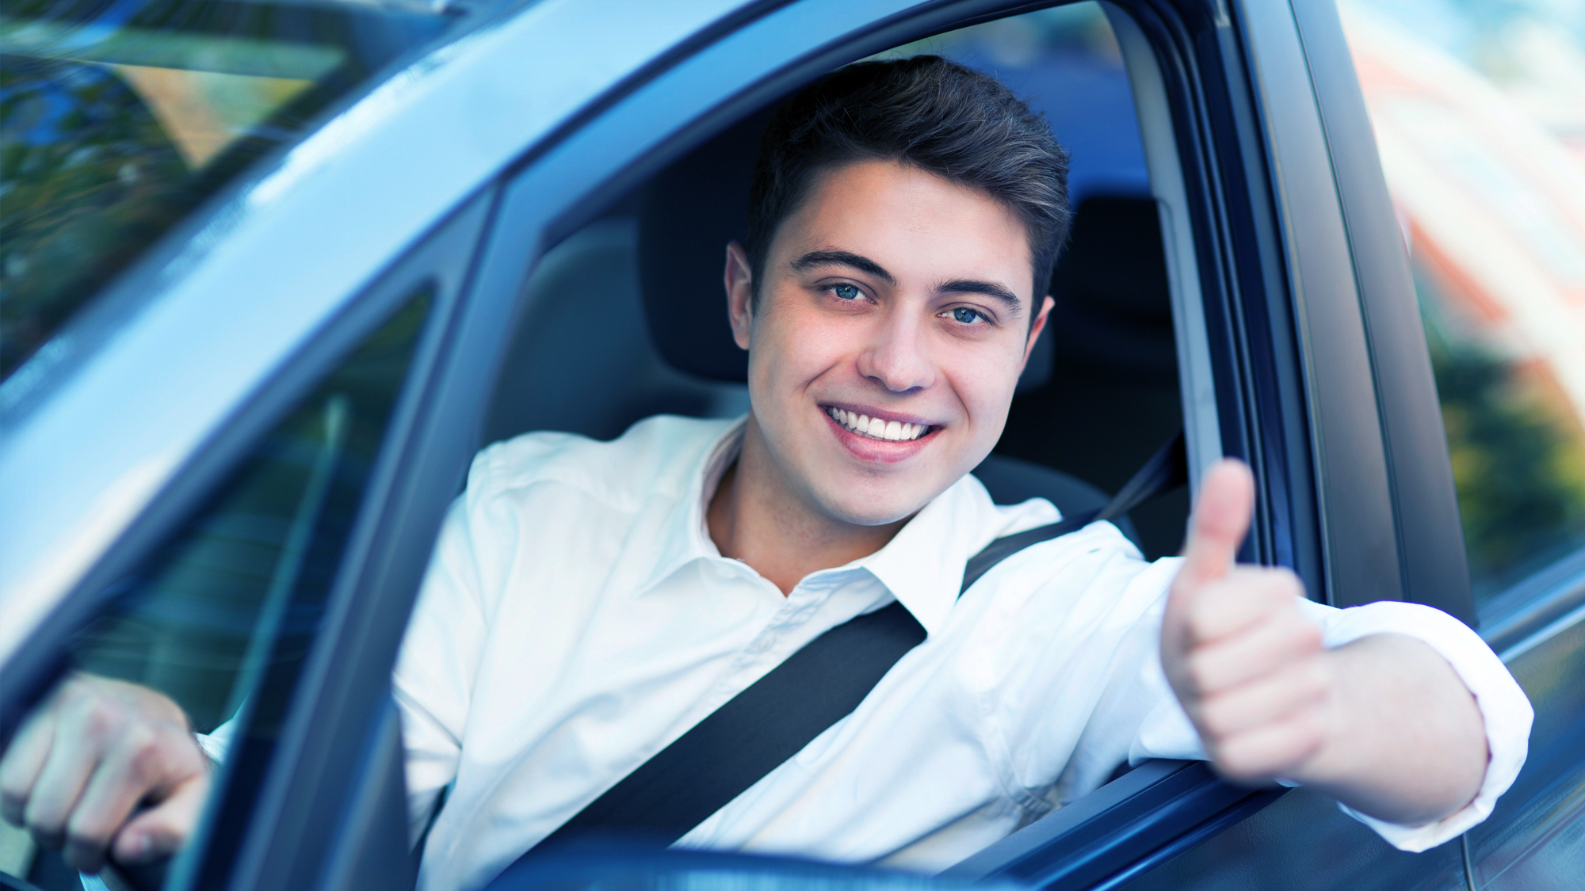
In conclusion…
Be prepared
and
always speak up
19

Slide 20
Remember… Jst Drv!
Keep Your Eyes
on the road
Hands
on the wheel
Mind
on driving
20

Slide 21
Free Safe Driving Resources
18 East 50th Street
New York, NY 10022
866-SAFEPATH (723-3728)
info@nrsf.org
www.nrsf.org • www.teenlane.org
@NRSForg
@NRSForg
@NRSForg
nationalroadsafety

